Slide 1

Internet of things (IOT)

Slide 2
Internet Of Things:
Definition:
A network of Items, Each Embedded With Sensors, Which are connected to the Internet.
ELEMENTS OF IOT:
Most of IOT architectures are built upon core fundamentals.
– Smarter Devices in a different form
– Network and Gateway that allows devices to be part of the IoT
– Middleware that includes data storage spaces and advances predicting capabilities
– End-user applications

Slide 3
IOT Layers
Perception Layer -manages smart devices across the system
Connectivity/Transport Layer -allows transferring data from the cloud to devices and vice-versa, different aspects of gateways and networks.
Processing Layer - controls and manages IoT levels for streamlining data across the system.
Application Layer- aids in the procedures of analytics, device control, and reporting to end-users
Business layer - derives information and decision-making analysis from data.
Security Layer - covers all aspects of protecting the whole IoT architecture
Edge Computing Layer - works at an edge or near the device information collection.

Slide 4
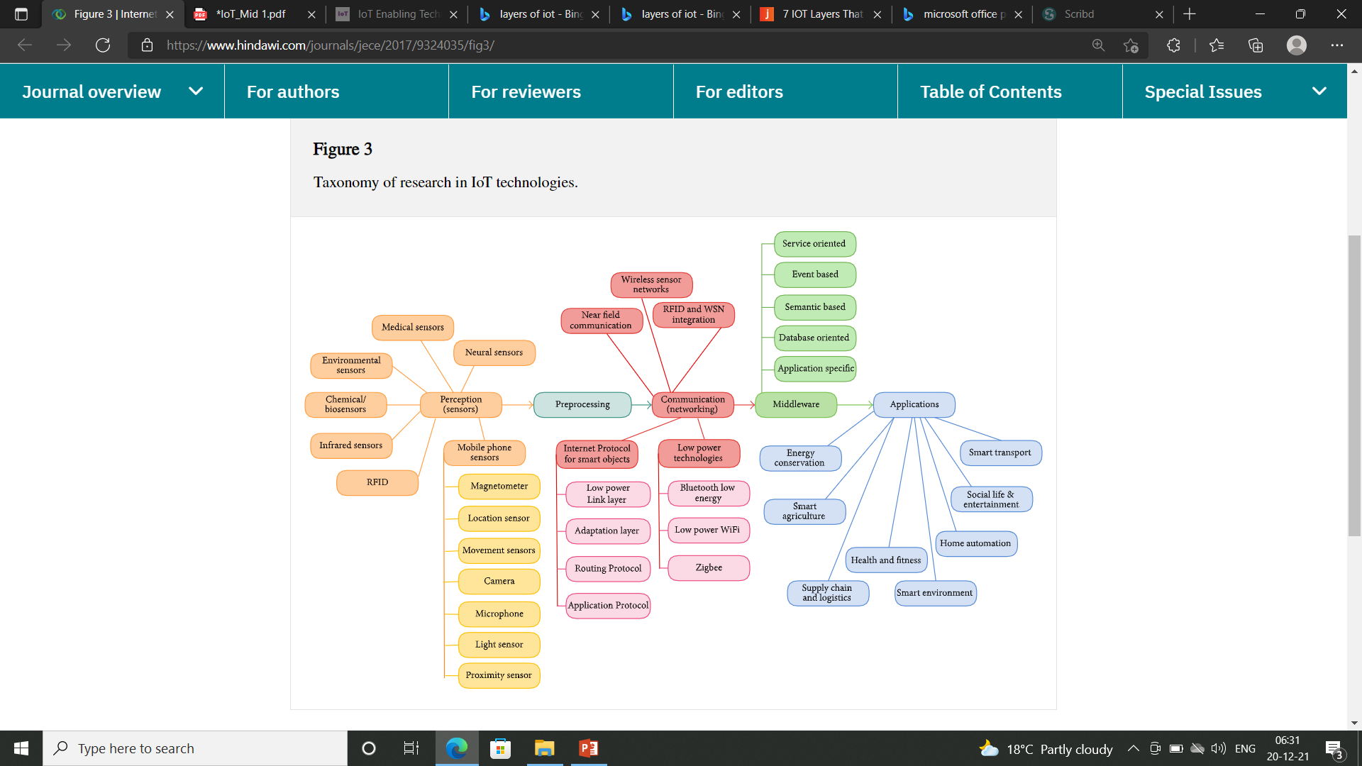

Slide 5
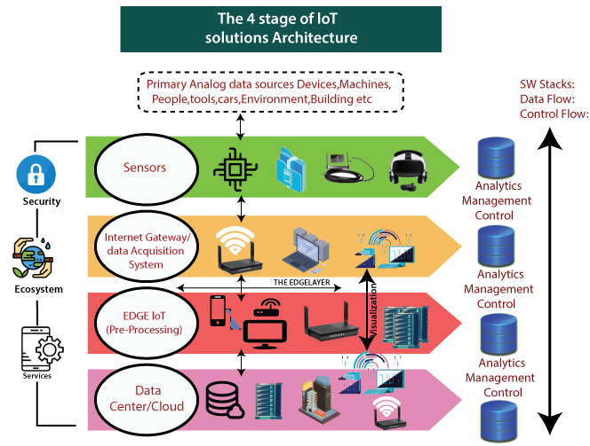

Slide 6
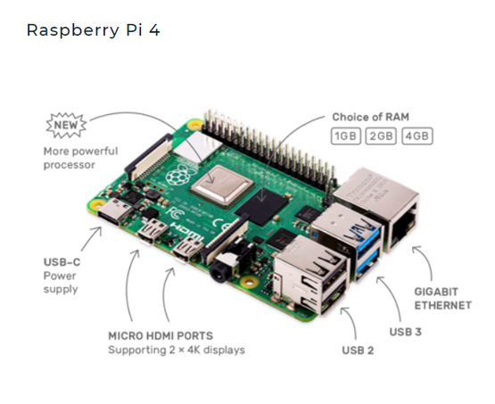
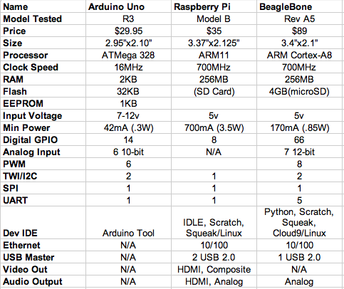
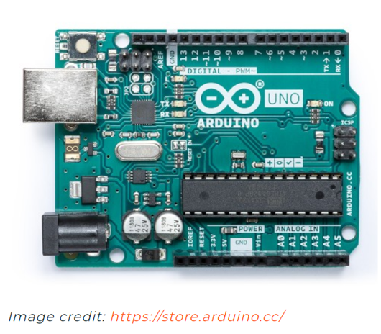
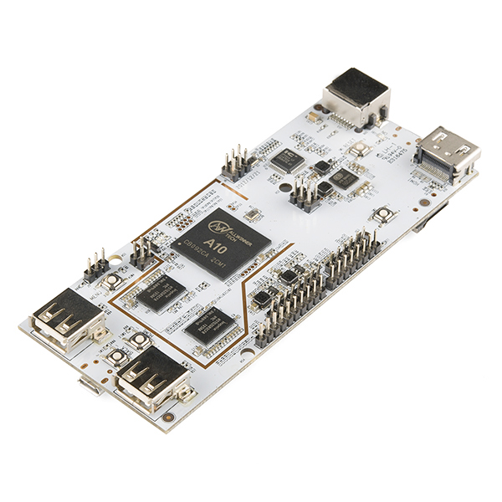
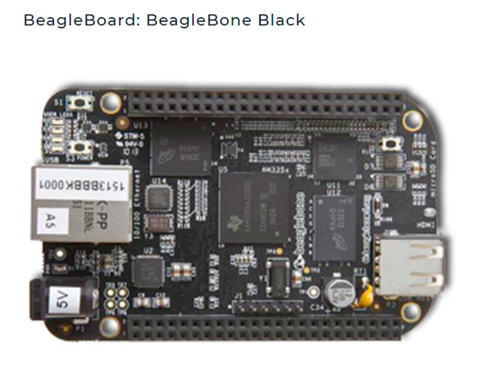
Micro Controllers:

Slide 7
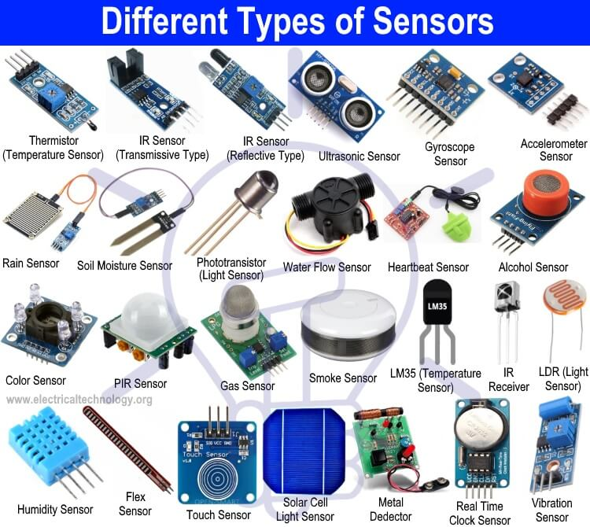
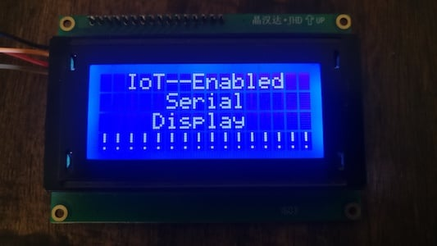


Slide 8
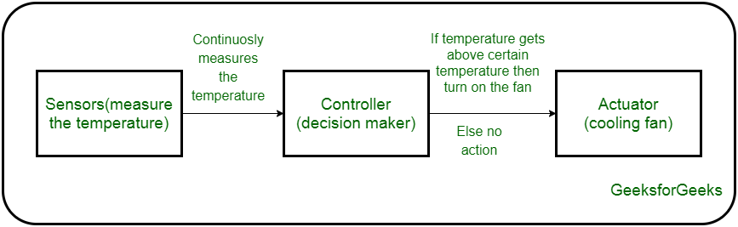
Sensor:
Converts Physical Phenomenon to Electrical Energy
Actuator:
Converts Electrical Energy to Physical Phenomenon

Slide 9
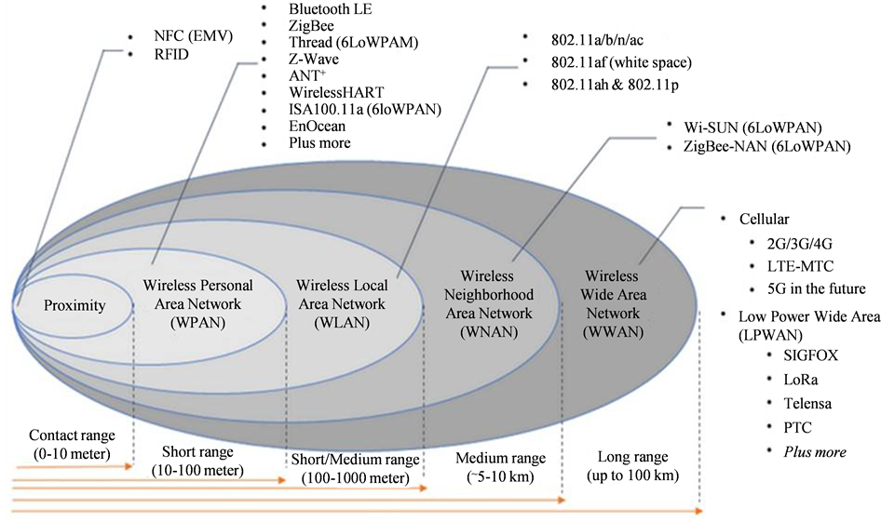
Communication

Slide 10
MIDDLEWARE
DATA CENTER/CLOUD
Application Softwares
APIs
SDKs
Software Frameworks
Applications
Software Security And Privacy
Data Storage – Information Generated by Things
Data Processing
Multiple Access
Data computation
Providers:
AWS
Microsoft
IBM
Salesforce

Slide 11
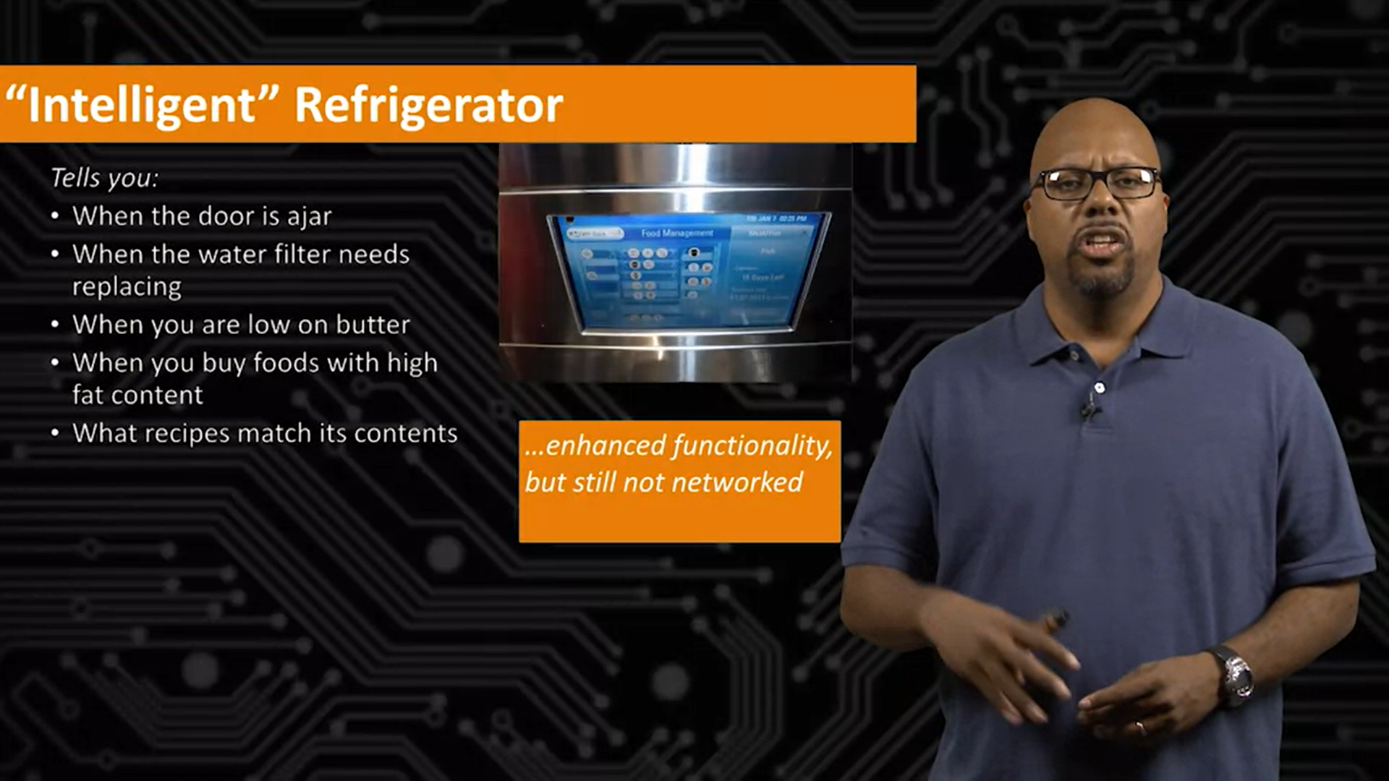
Example

Slide 12
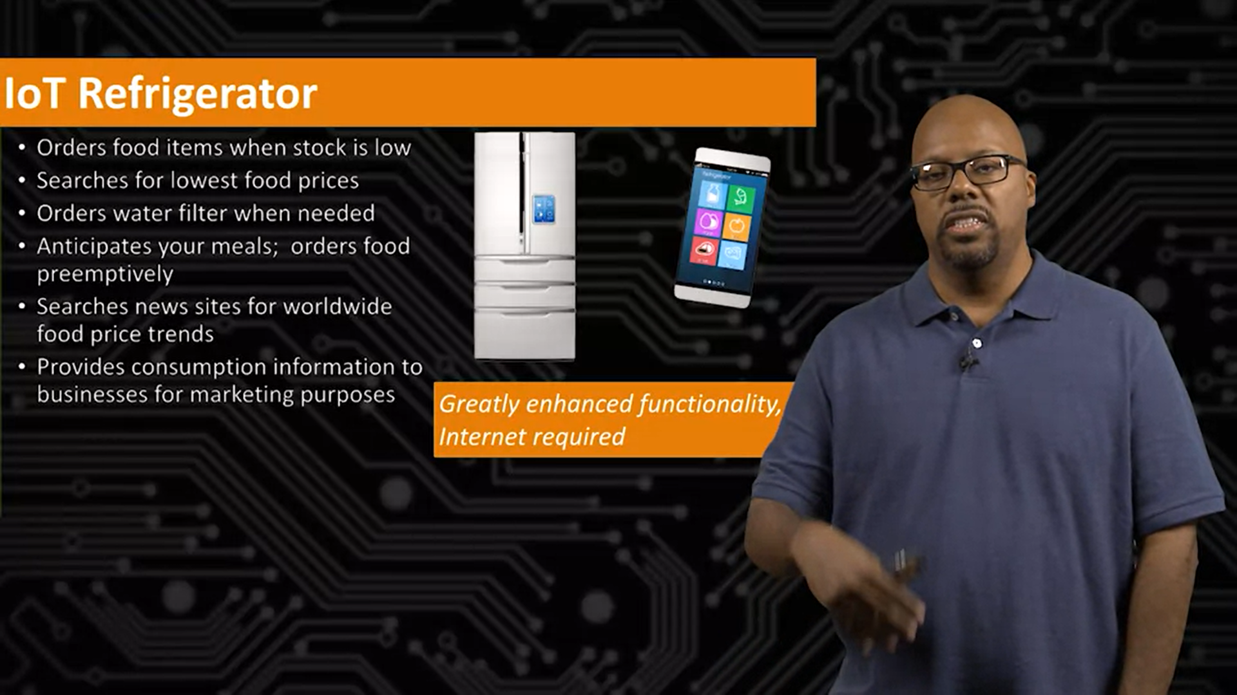

Slide 13
THANK YOU
PRESENTED BY
VANAJA MALLA

